Slide 1
Tech Mahindra
2016

Slide 2
Liferay portal

Slide 3
Agenda
Maven
Introductionnguage Introduction>
Installationes>
Features
Project in Eclipse
Demo

Slide 4
Introduction
Liferay Portal is a free and open source enterprise portal software product. Distributed under the GNU Lesser General Public License and optional commercial license.
Written in Java, Liferay Portal is a web platform with features commonly required for the development of websites and portals. Liferay includes a built-in web content management system allowing users to build websites and portals as an assembly of themes, pages, portlets/gadgets and a common navigation.Liferay is sometimes described as a content management framework or a web application framework.
Liferay Portal is Java-based and runs on any computing platform capable of running the Java Runtime Environment and anapplication server. Liferay is available bundled with a servlet container such as Apache Tomcat

Slide 5
Installation
Download liferay-ide-eclipse-updatesites-1.6.2.zip
Open eclipse, go to Help -> Install new software -> add, select the zip file and install. (In toolbar, liferay entries will get added)
Download liferay-plugins-sdk-6.1.1-master, liferay-portal-tomcat-jre-6.1.2-ce-ga3-20131212143815859
In eclipse, Windows -> preferences -> liferay -> installed plugin SDK, add the downloaded SDK
To set the liferay server runtime envinronment
Windows -> preferences -> server -> runtime environment -> add -> select Liferay Tomcat 7 and browse for liferay-portal-tomcat-jre-6.1.2-ce-ga3-20131212143815859 in your machine.

Slide 6
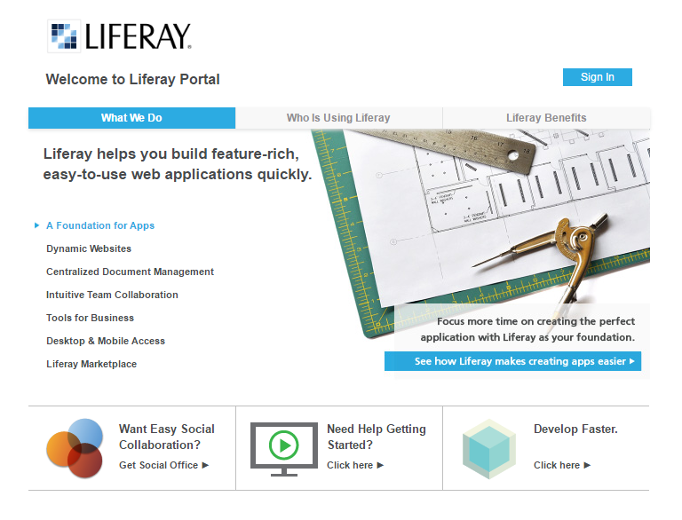
Installation
Start the liferay tomcat server
Right click on server, open a liferay home page. Sign-in and give required information.

Slide 7
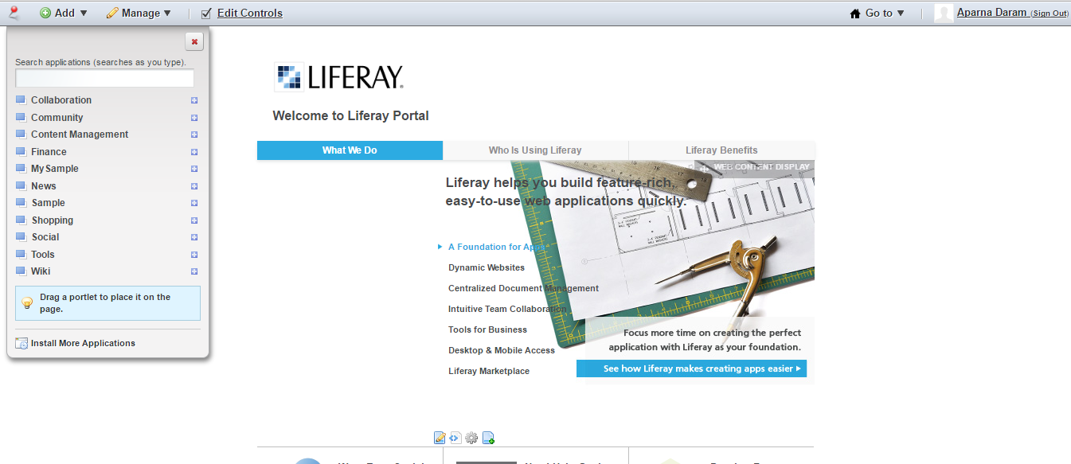
Features
Liferay comes with certain portlets preinstalled. These comprise the core functionality of the portal system. They include:
Alerts and Announcements
Asset Publishing
Calendar
Nested Portlets
Page Ratings & Flags
Software Catalog
Tags and Categories
Web Content
Web Form Builder, etc..
In Liferay portal, we can easily
create users, organizations,
sub organizations, roles and user
groups.

Slide 8
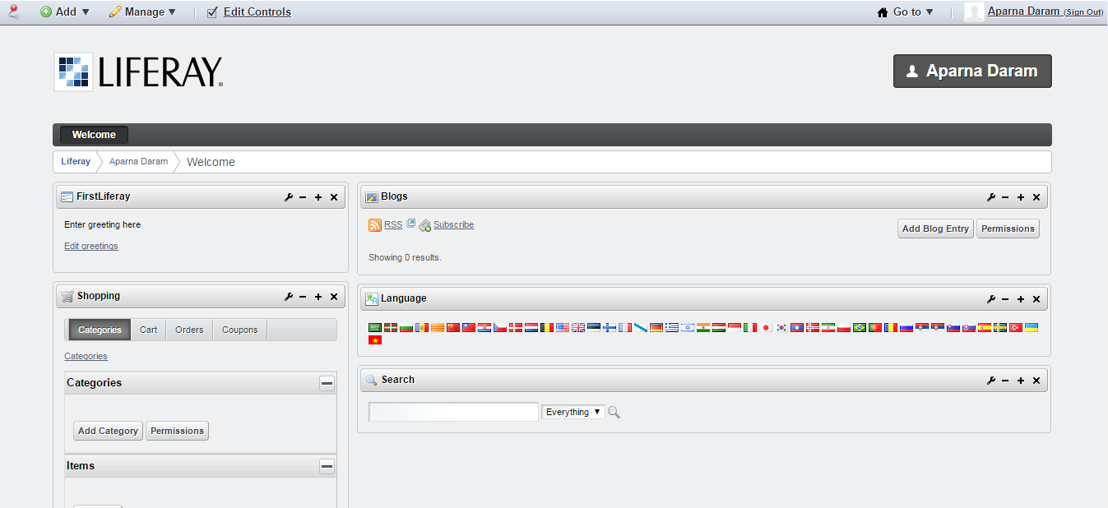
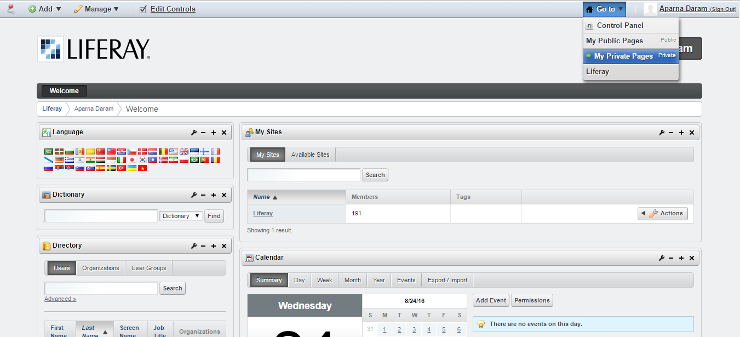
Features
Every user will have public pages (can be viewed by anyone without authentication), private pages(needs authentication)

Slide 9
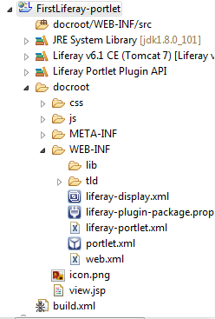
Liferay Project
Create a Liferay Project in Eclipse.
Select Portlet, and Liferay MVC
We will get the project in package explorer(liferay view)
It will contain docroot folder, jre libraries, Liferay portlet plugin API etc..

Slide 10
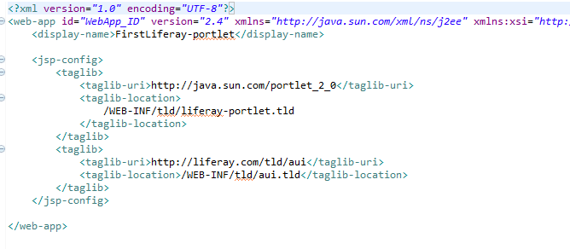
Liferay Project
View.jsp
Contains portlet data
Our portlet will be found in doc bar’s add->more-> sample when you run the project on server. We can drag it on to the page to view it.
Web.xml:
contains information like allow ui(aui.tld) and similar configurations like jstl

Slide 11
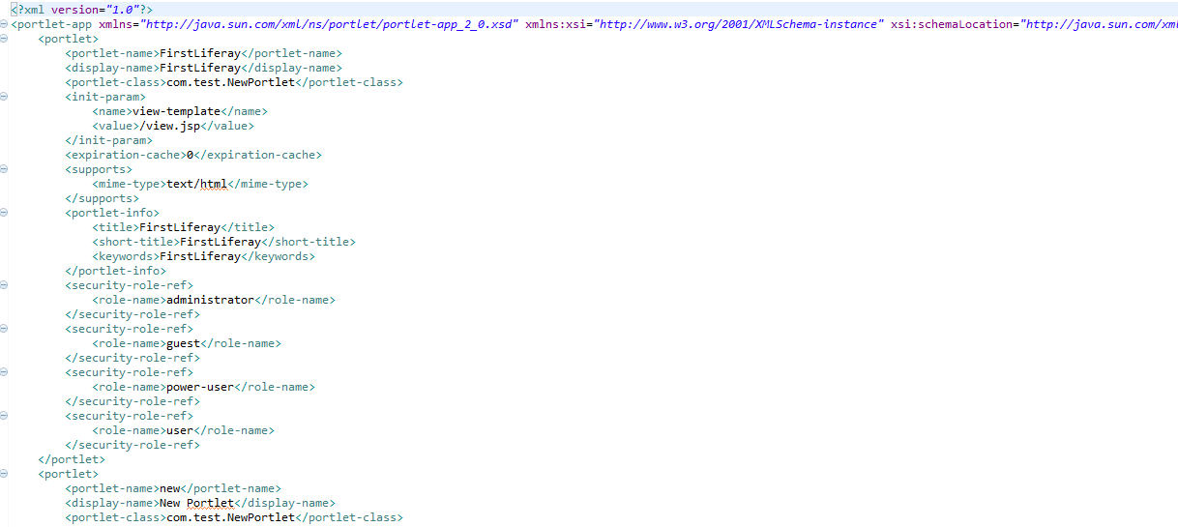
Liferay Project
Portlet.xml:
contains details of portlet info such as
Portlet-name, display-name, init-param (contains view.jsp by default), portlet-info, security-role-ref (contains who can view my portlet) tags

Slide 12
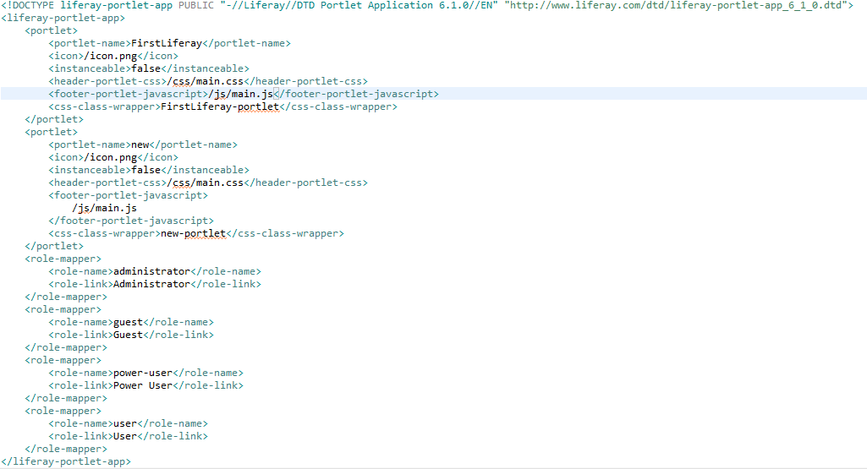
Liferay Project
Liferay-portal.xml:
which contains tags/elements such as portlet-name, icon, instanceable (false: means, we can have only once instance of that portlet), and role-mapper similar to that in portlet.xml

Slide 13
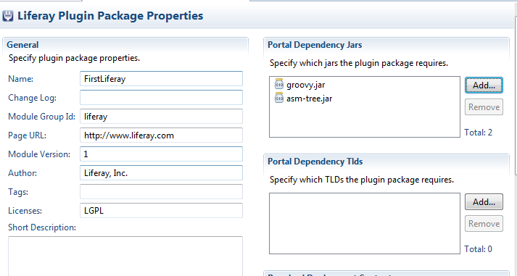
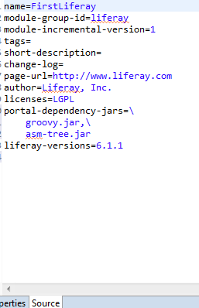
Liferay Project
Liferay-plugin-package.properties:
we can add jar files(if any) here. We can add from properties, and see it in source as “portlet-dependency-jar=\groovy.jar,\...,\...”.

Slide 14
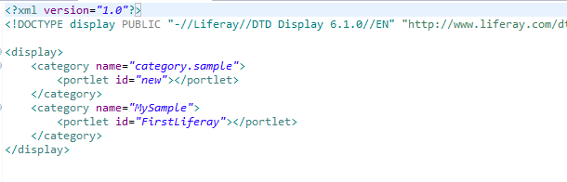
Liferay Project
Liferay-display.xml: contains information of where to display the portlet. (Default is inside add->more-> sample) we can change it or create new category of our wish.

Slide 15
Demo

Slide 16
Thank you

